Slide 1
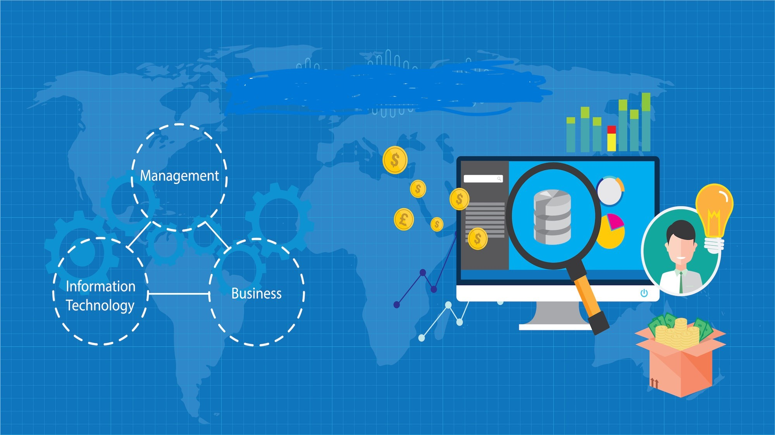
BUSINESS INTELLIGENCE PROJECT MANAGEMENT
PRESENTED BY :PRAMITA CHAKRABORTY
DATED ON :17.01.2025
Project Management Overview
Presented By :Pramita Chakraborty
Dated on : 17.01.2025

Slide 2
DEFINE THE PROJECT TOPIC BI INTELLIGENCE
What is Bi Intelligence
Business Intelligence (BI) refers to the technologies, applications, and practices used to collect, integrate, analyze, and present business information. The main goal of BI is to support better business decision-making. Here's a bit more detail:
Data Collection: Gathering data from various sources like databases, spreadsheets, APIs, etc.
Data Warehousing: Storing integrated data in a data warehouse for efficient querying and analysis.
Data Integration: Combining data from different sources into a cohesive dataset.
Data Analysis: Applying statistical and analytical techniques to extract meaningful patterns and insights.
Data Visualization: Creating visual representations of data, such as charts, graphs, and dashboards, to make insights more accessible.
.
Reporting: Generating reports to communicate findings to stakeholders.

Slide 3
PROJECT SCOPE
Defining the scope of a Business Intelligence (BI) project is crucial to ensure clear objectives and effective execution. Here are some steps to help you outline your project scope:
Objectives: Clearly define what you want to achieve with the BI project. Examples include improving decision-making, enhancing reporting capabilities, or identifying new business opportunities.
Stakeholders: Identify all the stakeholders involved, including project sponsors, data analysts, IT staff, and end-users. Their input and requirements are vital for success.
Requirements: Gather and document the functional and technical requirements. Functional requirements might include specific reports or dashboards, while technical requirements could involve data sources, integration needs, and security considerations.
Success Metrics: Define how you will measure the success of the project. This could include specific KPIs (Key Performance Indicators) such as improved sales, reduced costs, or increased efficiency.

Slide 4
Project Management Structure
Project Budget
Personnel Costs
Software and Licenses
Hardware
Data Acquisition
Consulting Services
Operational Costs
Contingency Fund
Project Risk
Data Quality Risks
Technical Risks
Project Scope Risks
Cost Overruns
Skill Gaps
Stakeholder Engagement
Change Management:

Slide 5
Project Management Structure
Project monitoring and control
Progress Tracking
Budget Management
Risk Management
Quality Control
Communication
Performance Metrics
Change Management
Documentation
Project closure
Completion Check
Stakeholder Approval
Final Report
Documentation
Budget Reconciliation
Resource Release
Evaluation
Formal Closure

Slide 6
Risk Management
Risk Identification: Identify potential risks that could affect the project or business. This can be done through brainstorming sessions, expert consultations, and reviewing historical data.
Risk Assessment: Evaluate the identified risks to determine their likelihood and potential impact. This helps in prioritizing the risks that need immediate attention.
Risk Analysis: Analyze the causes and consequences of each risk. This can include quantitative methods (like probability and impact analysis) and qualitative methods (like scenario analysis).
Risk Mitigation: Develop strategies to reduce or eliminate the impact of identified risks. This can include implementing preventive measures, developing contingency plans, and allocating resources for risk management.
Risk Monitoring: Continuously monitor and review risks throughout the project lifecycle. This helps in identifying new risks and assessing the effectiveness of risk mitigation strategies.
Risk Communication: Keep all stakeholders informed about the risks and the steps being taken to manage them. Clear and consistent communication is key to effective risk management.
Risk Documentation: Maintain detailed records of identified risks, assessments, mitigation plans, and monitoring activities. This documentation is valuable for future reference and continuous improvement.

Slide 7
Benefits
Enhancing decision-making for business intelligence (BI) involves leveraging data to make informed, strategic decisions. Here are some key strategies to improve decision-making in BI
Advanced Analytics: Utilize advanced analytics techniques such as predictive analytics, machine learning, and artificial intelligence to gain deeper insights and forecast future trends.
Collaborative Decision-Making: Foster a collaborative environment where different departments and stakeholders can share insights and contribute to the decision-making process.
Real-Time Reporting: Implement real-time reporting and dashboards to provide up-to-date information and enable timely decision-making.
Scenario Analysis: Conduct scenario analysis to explore different business outcomes and their impacts. This helps in understanding potential risks and opportunities.

Slide 8
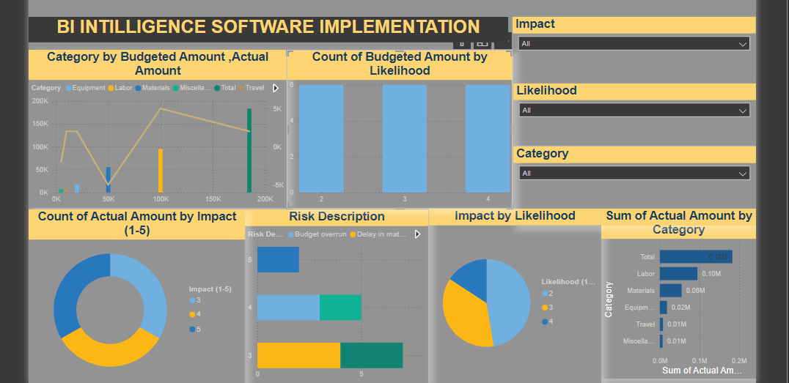

Slide 9
Conclusion
Implementing a BI software system can revolutionize how an organization handles and interprets data, leading to better business decisions and overall performance. This project will provide a thorough understanding of BI tools, project management practices, and data analysis methodologies.

Slide 10
THANK YOU

